Slide 1



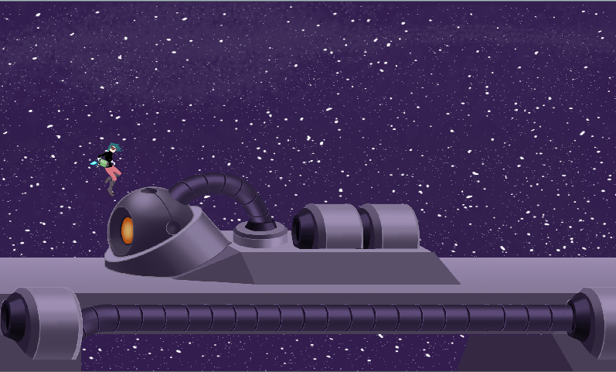
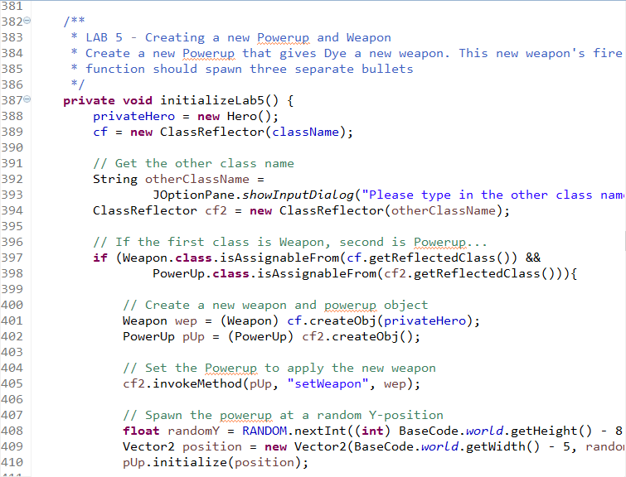
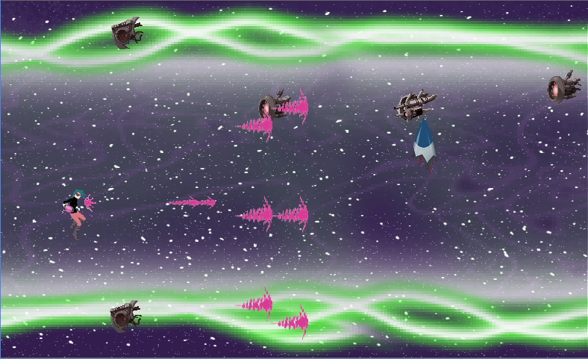
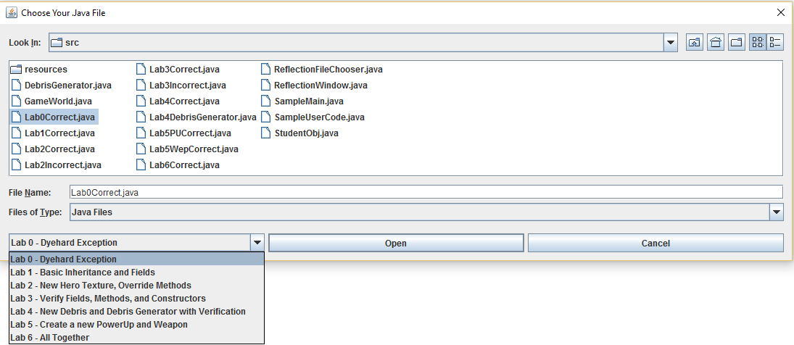

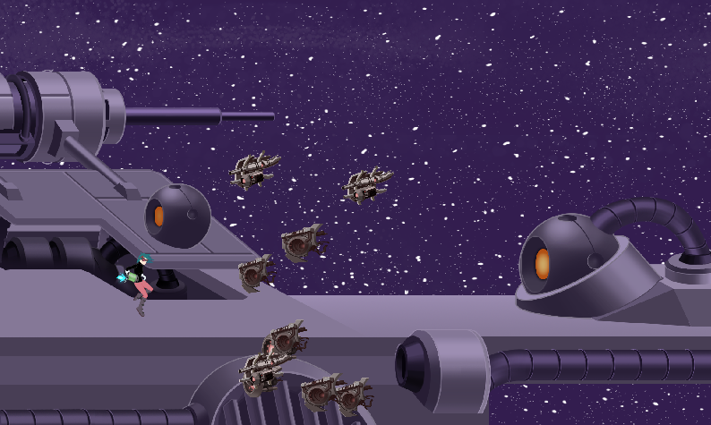
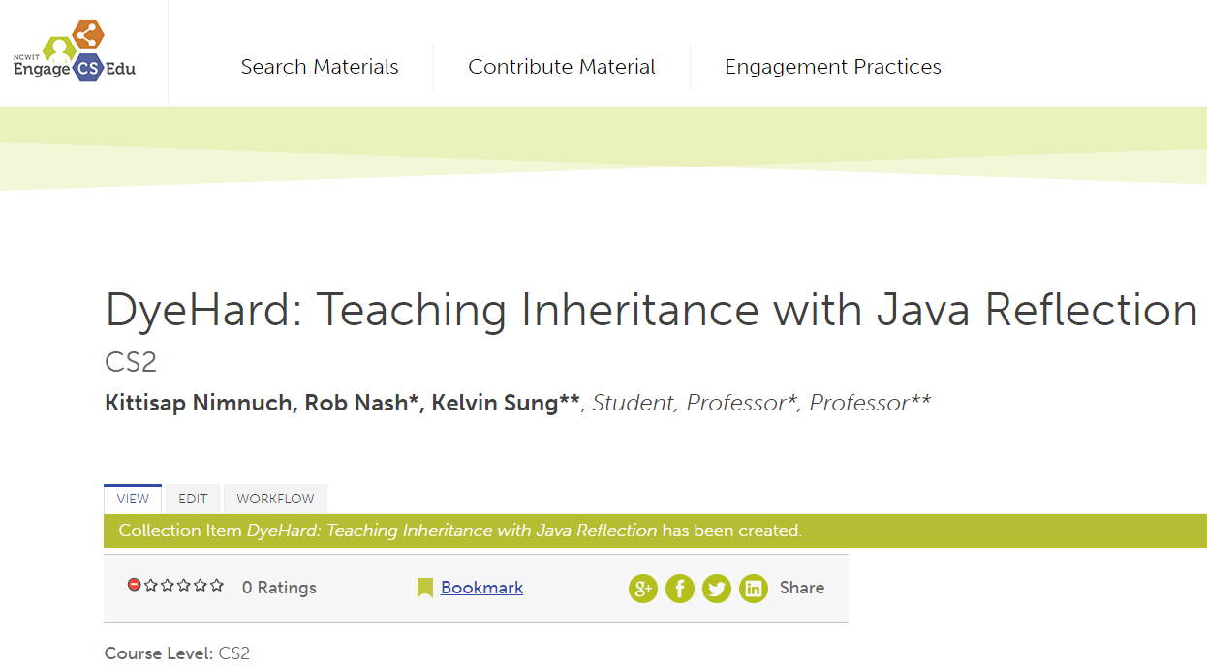


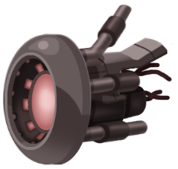
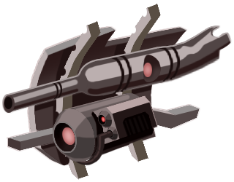

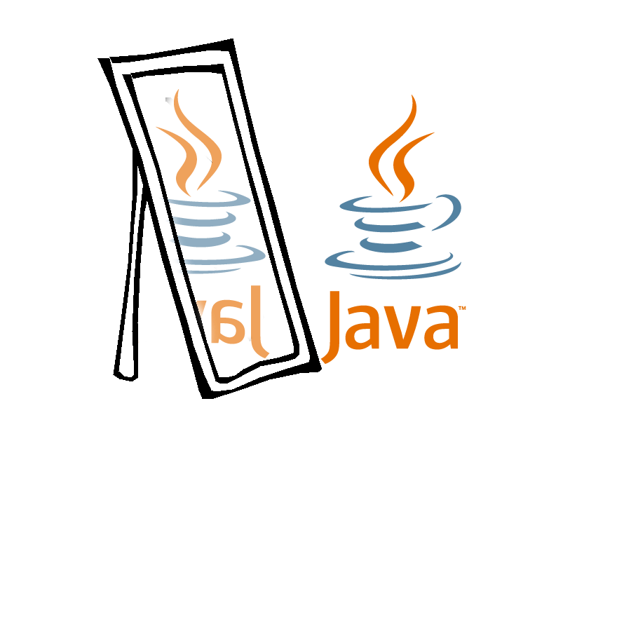
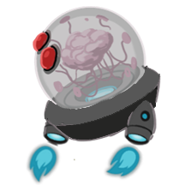

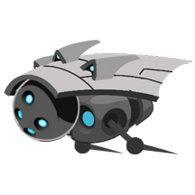


DYEHARD with REFLECTION in JAVA Teaching Inheritance using Real Time Simulations with GTCS
Kittisap “Sammy” Nimnuch
Advisors and Sponsors: Professor Rob Nash, Professor Kelvin Sung
Objective
What I Did
Results and Conclusion
Update the DyeHard codebase with comments and bug fixes
Using Java Reflection, build a tool that evaluates a student’s work and aide in teaching inheritance. This includes:
Performing basic error-checking
Analyzing a class at runtime in regards to its constructor and members
Streamlining the grading/evaluating process for class functionality
For the student, assist in preliminary code submission
Code refactor on existing DyeHard code
Large chunks of code were uncommented, no design doc
Created ClassReflector which handles the reflection process
This is the main class which can access, examine, and modify runtime objects and classes
Created seven lab activities that demonstrate how to use the reflection tool
Refactored and Commented existing DyeHard Code
Built a Reflection Tool
Built Proof of Concept Labs that demonstrates the Reflection Tool
Playtesting and submission to Google EngageEDU in Fall of 2016
Validator + Reflector File
What is DyeHard?
Simulation in which the player’s objective is to survive hordes of debris and space enemies until the end of the level is reached.
Can collect “power-ups” to vary gameplay
Space debris and enemies can be dyed by the hero’s gun. Different colors can be collected
One of six simulations built by GTCS (Game Themed Computer Science) for educational use
Created other simulations such as Space Smasher, Lynx, Ghost Light, Corrupted, and Hug the Line
Objective is to “integrate casual game content into introductory programming courses with minimum impact on their existing curriculum”
Lab Selector GUI
Lab Activity
What is Java Reflection?
Proof of Concept ( Labs)
Moving Forward
The process of examining or modifying the run time behavior of a class at run time
Dynamic code -- compiler does not need to know everything at compile time
Allows invocation of known methods for unknown classes
Excellent for class exploration, getters/setters validation, field verification, and inheritance hierarchy exploration
Can modify values and accessibility modifiers at runtime
Can be used to test programs by forcing it into a specific state
LAB 0 – Student creates a DyehardException class that handles java exceptions.
LAB 1 – Student defines basic inheritance and define float fields “width” and “height”
LAB 2 – Student define a new texture for the Hero. Test method overriding
LAB 3 – Verify and validate a class’ fields, methods, and constructors with another “correct” class file
LAB 4 – Student creates Debris and Debris Generator subclasses. Validate and verify fields, methods, constructors. Invoke new student methods
LAB 5 – Student creates PowerUp and Weapon subclasses. Invokes multiple methods overridden by Student
LAB 6 – Combine all concepts thus far to create a new level using all student subclasses
Make the tool more flexible and generic
Add extra features for real-time reflection to verify
Scale the reflector to work with any software
Create more prototype labs for use with reflection
Consider other educational targets to build labs against, in addition to Inheritance

